Slide 1
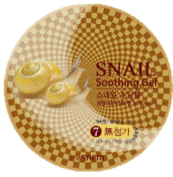
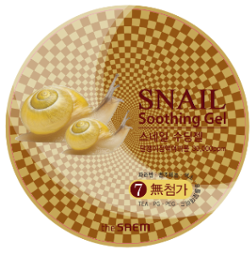
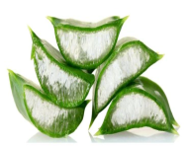
size/price : 300ml/ 6,000won | Product | Snail Soothing Gel
 | Key Selling point | Face & Body gel to soothe easily irritated skin while giving extra hydrating and firming effect.
 | How to Use | Spread generous amount of the soothing gel on face or body. Gently pat for better absorption.
Features | 1) Snail Mucin ‘Mucin’ contains rich amount of collagen and elastin. Also great in calming and decreasing the irritation. 2) Organic Aloe Vera from Jeju 4 times faster skin penetration rate than the mineral water. Lifting effect on the sagging skin caused by overexposure of the heat Has an antihistamine effect on the sun damage. 3) Various usage Use it as a moisturizer for body, hand, face and hair ends. Store in the refrigerator and use as a cooling mask. For everyone in the family, 4) Free of 7 harmful additives - Mild, gentle formulation. (Paraben, Benzophenon, artificial colorant, formaldehyde, PEG, PG, TEA)
Sales Talk | Famous 2 ingredients, Snail mucin and Aloe vera are combined to give the best skin renewing, healing and soothing effect! You must have heard of these 2 ingredients. The Saem has combined 2 great ingredients in very affordable price. The snail mucin will help the skin with renewing and healing, and the organic Aloe Vera from Jeju Island in Korea offers extra moisturizing and soothing effect. It has a very mild formula and can be used on anywhere and for anybody! Not only that, the price is amazing. You get 300ml for only 5,500 won !
NEW! Snail Soothing Gel
When Snail meets Aloe!
The renewing, firming power of snail meets the soothing and super moisturizing power of Aloe
Concept
Snail Mucin filtrate helps with skin renewal, wound healing and firming while Organic Aloe from the Jeju Island soothes and moisturizes the skin.
New, perfect soothing gel for the Face & Body
Firm
Moist
Everywhere
Mucin of the snail
Firms
Renews
Gives Luster
Organic Aloe Vera Leaf extract from the Jeju Island
Super Moisturizing
Soothing
Versatile usage
Face & Body
Can be used as a cooling mask when stored in refrigerator.

